Slide 1

Programming Principles
1811ICT/2807ICT/7001ICT
Week 7 Lecture
Dr Mardé Helbig

Slide 2



Recap: functions and scope
#ownFunction4.py
#define function with parameters and returning value
def finalBalance(d, c):
“”” returns the final balance after applying a discount
d is the discount that should be applied as a percentage
c is the cost before applying the discount”””
return d*c
#calling function
finalBalance(10, 120)
b = finalBalance(20, 200)
print(“Discounted balance: AUD”, b)
docstring
>python ownFunction4.py
Discounted balance: AUD 160
>
> python
>>>help()
help> ownFunction4.finalBalance
docstring is used by the help() function in the REPL
How can we return more than one value with a function?

Slide 3
Control and Data
Section 17: Tuples

Slide 4

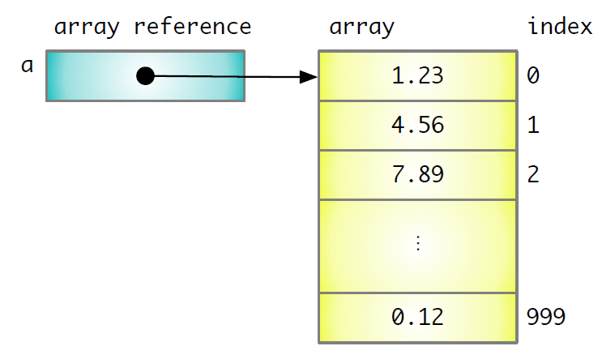
Traditional sequences
Traditionally programming languages use arrays
All elements are of the same type
Once created it has a fixed size
Index (position of element)
Elements (values)
But which sequences are available in Python?

Slide 5

tuples
Way to group or package together new values
Can have different types
Values separated by ,
Maintain the values in order
Immutable – once it is created it cannot be changed
> python
>>> (1, 2)
(1, 2)
>>> 1, 5
(1, 5)
>>>type((1,2))
<class ‘tuple’>
What happens if you use type(1, 2)?

Slide 6
tuples – multiple assignment
Can assign multiple values simultaneously if:
If left hand side has multiple values (tuple or list)
Length of sequence on the left is same as length of sequence on the right
> python
>>> x, y = 2, 7
>>> x
2
>>> y
7
>>> x, y
(2, 7)
>>> type((x, y))
<class ‘tuple’>

Slide 7
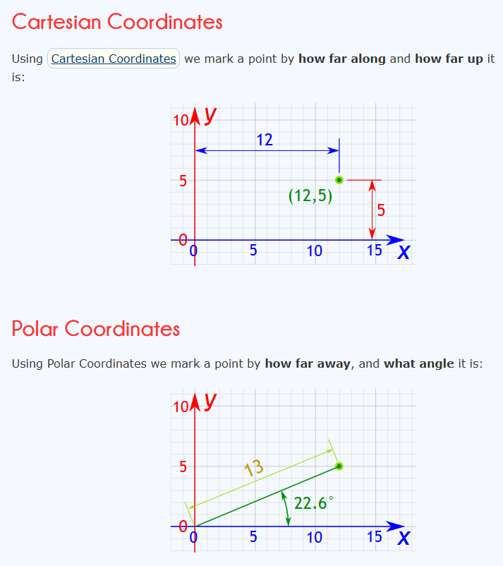
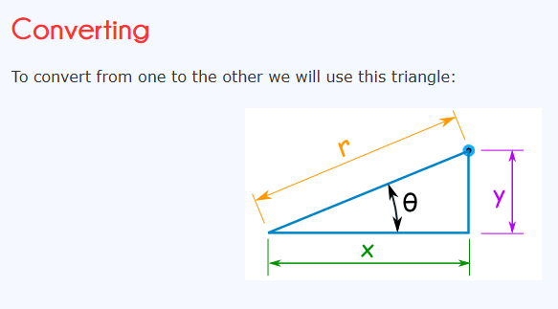
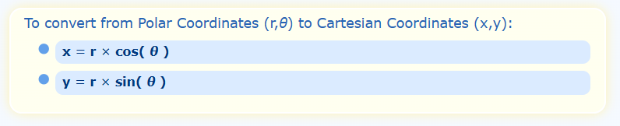
tuples – multiple return values
Can solve issue of returning multiple values in a function using a tuple
Problem: Write a function that converts polar coordinates to Cartesian coordinates
[1] Polar and Cartesian Coordinates
[1]

Slide 8
tuples – multiple return values
Can solve problem of returning multiple values in a function using a tuple
Polar and Cartesian Coordinates
#multipleReturnValues.py
from math import sin, cos
def polarToCartesian(r, theta):
"""Convert the polar coordinates (r, theta
(rad)) to Cartesian coordinates (x, y)."""
return (r * cos(theta), r * sin(theta))
> python multipleReturnValues.py
>
Why is nothing happening?

Slide 9
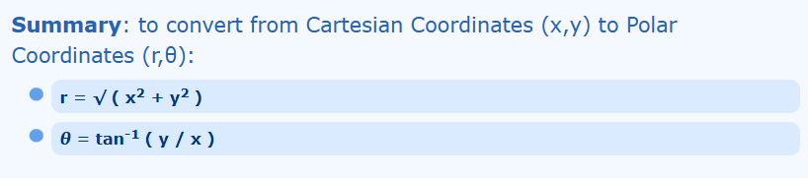
tuples – multiple return values
Can you solve the opposite problem, i.e. converting from Cartesian Coordinates to Polar Coordinates?
[1] Polar and Cartesian Coordinates
[1]

Slide 10

Any questions?
Type your question in the Q&A or raise your hand

Slide 11












Temperature Check
How do you feel about tuples?

Slide 12
Control and Data
Section 17: lists

Slide 13
Lists
Multiple values separated by ,
Maintain the values in order
Can be empty (zero elements)
Mutable – once it is created it can be changed and length can change
Written in [ ] to distinguish from tuple ()
Elements can be of different types

Slide 14
creating/constructing empty lists
2 ways to create an empty list:
> python
>>> x = list() #list constructor
>>> y = [ ] #literal expression
>>> x
[ ]
>>> y
[ ]
>>> x == y
True

Slide 15
creating/constructing non-empty lists
Approaches to create a non-empty list:
List constructor with sequence of values
Writing list literals with [ ]
Adding new elements to an existing list with append() method
List comprehensions
> python
>>> #examples of approach 1
>>> list(range(10))
[0, 1, 2, 3, 4, 5, 6, 7, 8, 9]
>>> list(range(3, 30, 5))
[3, 8, 13, 18, 23, 28, 33, 38]

Slide 16
creating/constructing non-empty lists
Approaches to create a non-empty list:
List constructor with sequence of values
Writing list literals with [ ]
Adding new elements to an existing list with append() method
List comprehensions
> python
>>> #examples of approach 2
>>> [1, “Hello”, 12.0]
[1, ‘Hello’, 12.0]
>>> [1, “Hello”, round] #can have a function here
[1, ‘Hello’, <built-in function round>]
>>> [1, “Hello”, round()]
Traceback (most recent call last):
File "<stdin>", line 1, in <module>
TypeError: round() missing required argument 'number' (pos 1)
>>>

Slide 17
creating/constructing non-empty lists
Approaches to create a non-empty list:
List constructor with sequence of values
Writing list literals with [ ]
Adding new elements to an existing list with append() method
List comprehensions
> python
>>> #examples of approach 3
>>> myList = [1, 2, 3, 4]
>>> myList.append(5) #adds 5 to end of list
>>> myList
[1, 2, 3, 4, 5]

Slide 18
creating/constructing non-empty lists
Approaches to create a non-empty list:
List constructor with sequence of values
Writing list literals with [ ]
Adding new elements to an existing list with append() method
List comprehensions
> python
>>> #examples of approach 4
>>> [ i for i in range(10)]
[0, 1, 2, 3, 4, 5, 6, 7, 8, 9]
>>> [i*i for i in range(10)]
[0, 1, 4, 9, 16, 25, 36, 49, 64, 81]
>>> [5*i for i in range(10)]
[0, 5, 10, 15, 20, 25, 30, 35, 40, 45]
>>> [5*i for i in range(3, 10, 2)]
>>> [i*i for i in range(10)]
[15, 25, 35, 45]

Slide 19
Any questions?
Type your question in the Q&A or raise your hand

Slide 20
Temperature Check
How do you feel about lists?

Slide 21
Control and Data
Section 17: sequences

Slide 22
Sequences
Learned about 3 types of sequences in Python:
String
Tuple
List
“Howdy mate”
(23, 45.2)
[23, “bye”, round]

Slide 23
operations on Sequences: indexing
Selecting a specific element by its position in the sequence
Position is indicated by a number in square brackets
First element’s position (or index) is zero
> python
>>> #examples of indexing
>>> myTuple = (“Happy birthday”, 2, “you”)
>>> myTuple[0]
‘Happy birthday’
>>>
>>> myString = “Goodbye mate!”
>>> myString[0]
‘G’
>>>
>>> myList = [20, ‘hallo’, round]
>>> myList[0]
20

Slide 24
operations on Sequences: indexing
First element’s position (or index) is zero, second is 1, third is 2, etc.
Last element’s position (or index) is -1, second last is -2, etc.
> python
>>> #examples of indexing
>>> myTuple = (“Happy birthday”, 2, “you”)
>>> myTuple[-1]
‘you’
>>>
>>> myString = “Goodbye mate!”
>>> myString[-1]
‘!’
>>>
>>> myList = [20, ‘hallo’, round]
>>> myList[-1]
<built-in function round>
>>> myList[-2]
‘hallo’

Slide 25
operations on Sequences: Slicing
Slicing allows selection of a subset of the sequence
Can be more than one element
Last element’s position (or index) is -1, second last is -2, etc.
[ ] with the : indicates slicing
[start : end : step]
second : is followed by step size and is optional, default is 1
starting index, default is 0
ending index (not inclusive), default is -1 (inclusive)

Slide 26
operations on Sequences: Slicing
[start : end : step]
> python
>>> #examples of slicing
>>> s = “abcdefghijklmnopqrstuvwxyz’
>>> s[2:6] #returns elements 2 to 5
‘cdef’
>>> s[:6] #returns elements 0 to 5
‘abcdef’
>>> s[4:] #returns elements 4 to -1
‘defghijklmnopqrstuvwxyz’
>>> s[2:-2:2]
'cegikmoqsuw'

Slide 27
operations on Sequences: concatenation
+ operator (concatenation) joins sequences
> python
>>> #examples of concatenation
>>> (1, 3) + (7, 9)
(1, 3, 7, 9)
>>>
>>> “good” + “ “ + “morning”
‘good morning’
>>>
>>> [2.5, “hi”, round] + [10, abs]
[2.5, 'hi', <built-in function round>, 10, <built-in function abs>]

Slide 28
operations on Sequences: repetition
* operator (repetition) joins multiple copies of a sequence
> python
>>> #examples of repetition
>>> (2, 5)*3
(2, 5, 2, 5, 2, 5)
>>>
>>> [1]*5
[1, 1, 1, 1, 1]
>>>
>>> ‘ha’*10
'ha ha ha ha ha ha ha ha ha ha '

Slide 29
operations on Sequences: in/not in
in or not in test whether or not a value occurs within a sequence
> python
>>> #examples of in and not in
>>> 5 in [2 5 20]
True
>>>
>>> ll in ‘hello’
Traceback (most recent call last):
File "<stdin>", line 1, in <module>
NameError: name 'll' is not defined. Did you mean: 'all’?
>>>
>>> ‘ll’ in ‘hello’
True
>>> 5 not in [2 5 20]
False
>>> 7 not in [2 5 20]
True

Slide 30
operations on Sequences: relational
All relational operators can be used to compare sequences
Comparison is done lexicographically, not on length
> python
>>> #examples of relational operators
>>> [5] < [2, 20]
False
>>> [5, 20] < [20]
True
>>> [1, 2] == [1]
False
>>> [1] == [1]
True

Slide 31
Any questions?
Type your question in the Q&A or raise your hand

Slide 32

5 Minute Break Time!

Slide 33
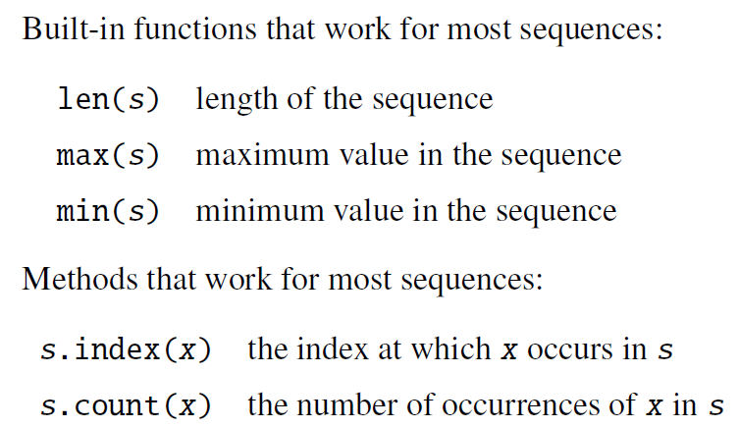
operations on Sequences: built-in methods
> python
>>> #examples of built-in methods
>>> s = [i*2 for i in range(5)]
>>> s
[0, 2, 4, 6, 8]
>>> len(s)
5
>>> max(s)
8
>>> min(s)
0
>>> s.index(4)
4
>>> s.index(7)
Traceback (most recent call last):
File "<stdin>", line 1, in <module>
ValueError: 7 is not in list

Slide 34
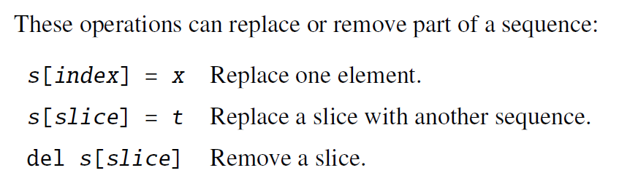
operations on Sequences: modifying lists
> python
>>> #examples of built-in methods
>>> s = [i*2 for i in range(5)]
>>> s
[0, 2, 4, 6, 8]
>>> s[2] = 11
>>> s
[0, 2, 11, 6, 8]
>>> s[1:3] = [3, 6, 9, 12]
>>> s
[0, 3, 6, 9, 12, 6, 8]
>>> t = (4, 2.5, ‘hello’, 3)
>>> t[2] = 20.5
Traceback (most recent call last):
File "<stdin>", line 1, in <module>
TypeError: 'tuple' object does not support item assignment
Why do we get this error?

Slide 35
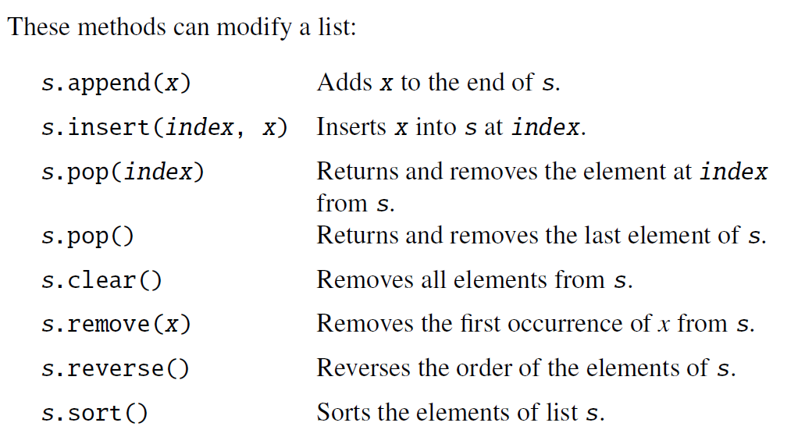
operations on Sequences: modifying lists
> python
>>> #examples of built-in methods
>>> s = [i*2 for i in range(5)]
>>> s
[0, 2, 4, 6, 8]
>>> s.append(20) #adds 20 to end of list
>>> s
[0, 2, 4, 6, 8, 20]
>>> s.insert(3, 50) #adds 50 at index 3
>>> s
[0, 2, 4, 50, 6, 8, 20]
>>> print(s.pop(1)) #returns and removes element at index 1
2
>>> s
[0, 4, 50, 6, 8, 20]
>>> print(s.pop()) #returns and removes last element
20
>>> s
[0, 4, 50, 6, 8]

Slide 36
operations on Sequences: modifying lists
> python
>>> #continued examples of built-in methods
>>> s
[0, 4, 50, 6, 8]
>>> s.append(6) #adds 6 to end of list
>>> s
[0, 4, 50, 6, 8, 6]
>>> s.remove(6) #removes first occurrence of 6
>>> s
[0, 4, 50, 8, 6]
>>> s.reverse() #reverses order of elements
>>> s
[6, 8, 50, 4, 0]
>>> s.sort() #sorts elements in ascending order
>>> s
[0, 4, 6, 8, 50]
>>> s.clear() #removes all elements
>>> s
[ ]

Slide 37
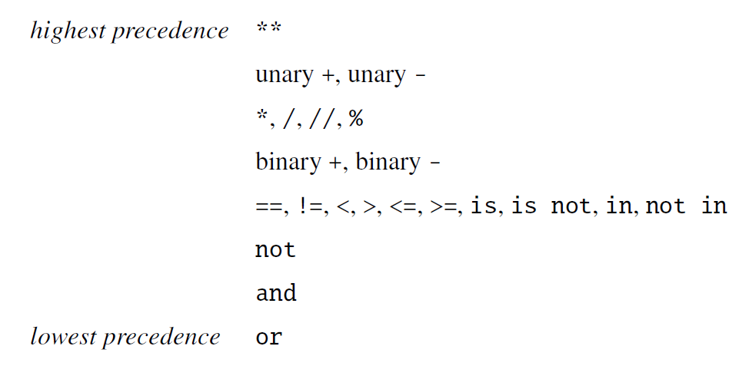
operations on Sequences: operators
Precedence of operators

Slide 38
Any questions?
Type your question in the Q&A or raise your hand

Slide 39
Temperature Check
How do you feel about sequences?

Slide 40
Control and Data
Section 17: problem examples

Slide 41

problem 1
Write a function to sort a list descending order in place without using built-in Python sort functions
15
4
11
30
8
4
88
1
Check each of these elements
If larger than 15, swap them

Slide 42
problem 1
Write a function to sort a list descending order in place without using built-in Python sort functions
15
4
11
30
8
4
88
1

Slide 43
problem 1
Write a function to sort a list descending order in place without using built-in Python sort functions
30
4
11
15
8
4
88
1
Check each of these elements
If larger than 30, swap them
15
4
11
30
8
4
88
1

Slide 44
problem 1
Write a function to sort a list descending order in place without using built-in Python sort functions
30
4
11
15
8
4
88
1

Slide 45
problem 1
Write a function to sort a list descending order in place without using built-in Python sort functions
88
4
11
15
8
4
30
1
30
4
11
15
8
4
88
1

Slide 46
problem 1
Write a function to sort a list descending order in place without using built-in Python sort functions
88
4
11
15
8
4
30
1
Check each of these elements
If larger than 4, swap them

Slide 47
problem 1
Write a function to sort a list descending order in place without using built-in Python sort functions
88
4
11
15
8
4
30
1

Slide 48
problem 1
Write a function to sort a list descending order in place without using built-in Python sort functions
88
11
4
15
8
4
30
1
88
4
11
15
8
4
30
1

Slide 49
problem 1
Write a function to sort a list descending order in place without using built-in Python sort functions
j
counter over rest of indices: i+1 to len(myList)
15
4
11
30
8
4
88
1
i
counter over indices: 0 to len(myList)-1

Slide 50
problem 1
Write a function to sort a list descending order in place without using built-in Python sort functions
#descendingSort.py
#define function to sort a list in descending order
def sort(aList):
"""soring a list in descending order"""
#counter over all elements except the last one (inner loop manages that element)
for i in range(0, len(aList)-1):
#counter over all elements after i
for j in range(i+1, len(aList)):
#if element after i is larger than the element at i
if (aList[j] > aList[i]):
#swap the two values
aList[i], aList[j] = aList[j], aList[i]
s = [1, 30, 5, 88]
sort(s)
print(s)
s = [1, 30, 90, 30, 5, 88]
sort(s)
print(s)
> python descendingSort.py
[88, 30, 5, 1]
[88, 30, 5, 1]
[90, 88, 30, 30, 5, 1]

Slide 51
problem 2
Write a function that counts the number of times a value occurs in a list
#countingOccurrence.py
def occurrence(aList, aValue):
"""returning the number of times a value occurs within a list"""
count = 0
for i in range(0, len(aList)):
if (aList[i]==aValue): #what is wrong here?
count += 1
return count
s = [1, 30, 5, 88]
print(occurrence(s, 30))
s = [1, 30, 5, 88]
print(occurrence(s, 3))
s = [1, 30, 5, 88, 30, 6, -30]
print(occurrence(s, 30))
s = [1, 30, 5, 'hello', 88, 'hi', 30, 6, -30]
print(occurrence(s, 'hello'))
> python countingOccurrence.py
1
0
2
1

Slide 52
Any questions?
Type your question in the Q&A or raise your hand

Slide 53
Temperature Check
How do you feel about solving problems using sequences?

